Slide 2
Topics
Introduction to Repetition Structures
The while Loop: a Condition-Controlled Loop
The for Loop: a Count-Controlled Loop
Calculating a Running Total
Sentinels
Input Validation Loops
Nested Loops
Using break, continue, and else with Loops

Slide 3
Introduction to Repetition Structures
Often must write code that performs the same task multiple times
Disadvantages to duplicating code
Makes program large
Time consuming
May need to be corrected in many places
Repetition structure: makes computer repeat included code as necessary

Slide 4
Condition-Controlled and Count-Controlled Loops
There are two broad categories of loops:
Condition-controlled
uses a true/false condition to control the number of times the loop iterates
Count-controlled
repeats a specific number of times

Slide 5
The while Loop: a Condition-Controlled Loop
while loop: while condition is true, do something
Two parts:
Condition tested for true or false value
Statements repeated as long as condition is true
General format:
while condition:
statements

Slide 6
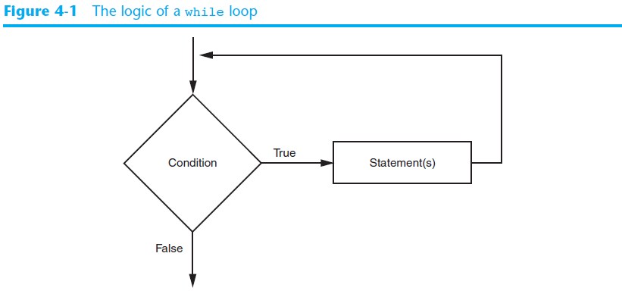
The while Loop: a Condition-Controlled Loop (cont’d.)

Slide 7
The while Loop: a Condition-Controlled Loop (cont’d.)
In order for a loop to stop executing, something has to happen inside the loop to make the condition false
Iteration: one execution of the body of a loop
while loop is known as a pretest loop
Tests condition before performing an iteration
Will never execute if condition is false to start with
Requires performing some steps prior to the loop

Slide 8
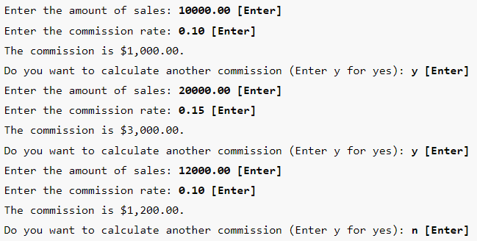
The while Loop: Example
For example, suppose you have been asked to write a program that calculates a 10 percent sales commission for several salespeople.

Slide 9
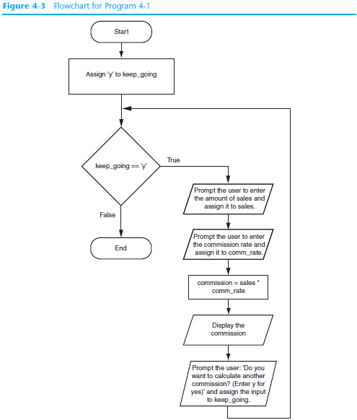
The while Loop: Example

Slide 10
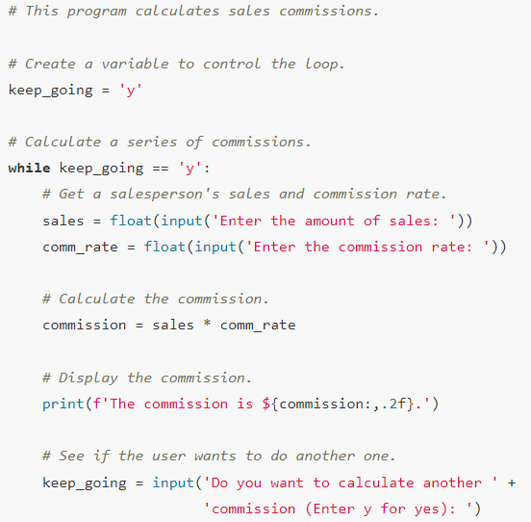
The while Loop: Example

Slide 11
Infinite Loops
Loops must contain within themselves a way to terminate
Something inside a while loop must eventually make the condition false
Infinite loop: loop that does not have a way of stopping
Repeats until program is interrupted
Occurs when programmer forgets to include stopping code in the loop

Slide 12
Using the while Loop as a Count-Controlled Loop
The while loop is inherently a condition-controlled loop
It repeats as long as a Boolean condition is true
However, you can use the while loop as a count-controlled loop by pairing it with a counter variable
A counter variable is assigned a unique value during each iteration of a loop.
It is called a counter variable because it can be used to count the number of times the loop iterates

Slide 13
Using the while Loop as a Count-Controlled Loop
A count-controlled while loop must perform three actions:
Initialization: The counter variable must be initialized to a suitable starting value before the loop begins.
Comparison: The loop must compare the counter variable to a suitable ending value, to determine whether the loop should iterate or not.
Update: During each iteration, the loop must update the counter variable with a new value.
Initialization
n = 0
while n < 5:
print(f'Inside the loop, the value of n is {n}.')
n += 1
Comparison
Update

Slide 14
Single-Line while Loops
If there is only one statement in the body of a while loop, you can write the entire loop on one line.
General format: while condition: statement
Example: n = 0 while n < 10: n += 1

Slide 15
The for Loop: a Count-Controlled Loop
Count-Controlled loop: iterates a specific number of times
Use a for statement to write count-controlled loop
General format:
for variable in [val1, val2, etc]:
statements

Slide 16
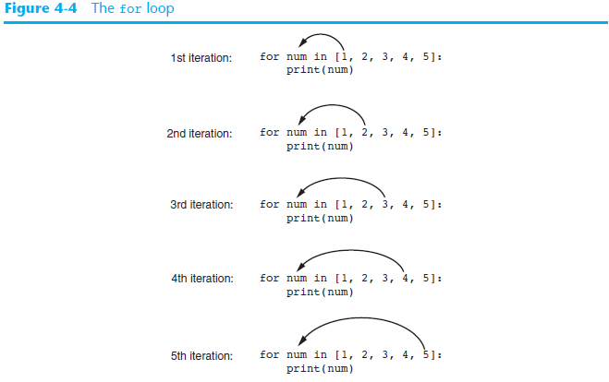

Slide 17

Using the range Function with the for Loop
The range function simplifies the process of writing a for loop
range returns an iterable object which is a sequence of values that can be iterated over
Below, instead of using a list of values, we call the range function passing 5 as an argument
The range function will generate an iterable sequence of integers in the range of 0 up to (but not including) 5 and thus the program displays the numbers: 0 1 2 3 4

Slide 18

Using the range Function with the for Loop
If you pass one argument to the range function, as shown in the previous example, that argument is used as the ending limit of the sequence of numbers.
If you pass two arguments to the range function, the first argument is used as the starting value of the sequence, and the second argument is used as the ending limit as shown below:
The code displays: 1 2 3 4

Slide 19

Using the range Function with the for Loop
By default, the range function produces a sequence of numbers that increase by 1 for each successive number in the list.
If you pass a third argument to the range function, that argument is used as step value.
The code displays: 1 3 5 7 9

Slide 20
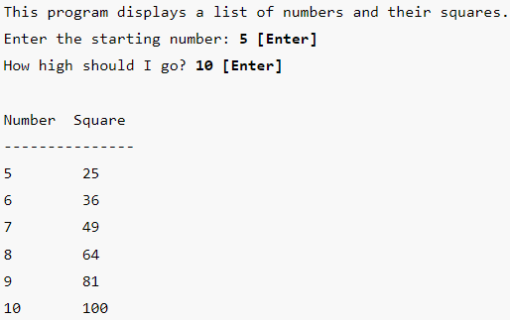
Example of a for Loop
Suppose you need to write a program that displays a table of numbers and it’s square as shown below. The user is first asked to enter the starting and ending number.

Slide 21
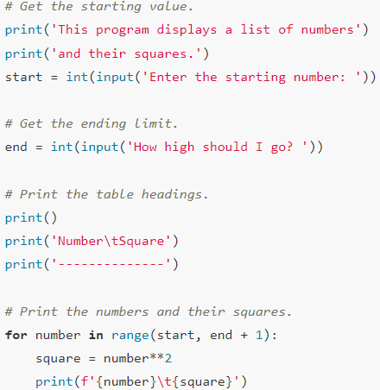
Example of a for Loop
Code:

Slide 22
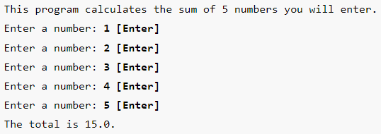
Example of a for Loop
Let’s look at a program that calculates a running total. The program should allow the user to enter five numbers and then display the total of the numbers entered.

Slide 23
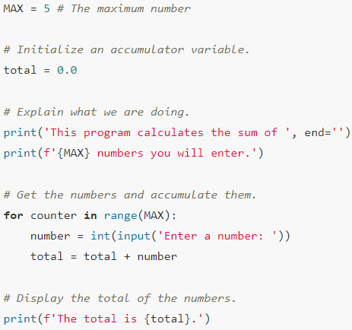
Example of a for Loop
Code:

Slide 24
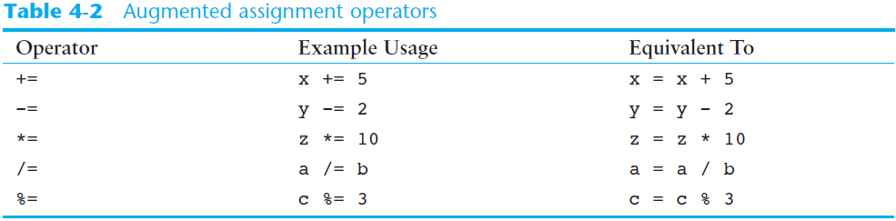
The Augmented Assignment Operators
In many assignment statements, the variable on the left side of the = operator also appears on the right side of the = operator
Augmented assignment operators: special set of operators designed for this type of job
Shorthand operators
In the previous example, total = total + number can be written as total += number.

Slide 25
Sentinels
Sentinel: special value that marks the end of a sequence of items
When program reaches a sentinel, it knows that the end of the sequence of items was reached, and the loop terminates
Must be distinctive enough so as not to be mistaken for a regular value in the sequence
Example: when reading an input file, empty line can be used as a sentinel

Slide 26
Sentinels Example
The county tax office calculates the annual taxes on property using the following formula: property tax = property value × 0.0065
Every day, a clerk in the tax office gets a list of properties and has to calculate the tax for each property on the list.
You have been asked to design a program that the clerk can use to perform these calculations.
In your interview with the tax clerk, you learn that each property is assigned a lot number, and all lot numbers are 1 or greater.
You decide to write a loop that uses the number 0 as a sentinel value. During each loop iteration, the program will ask the clerk to enter either a property’s lot number, or 0 to end.

Slide 27
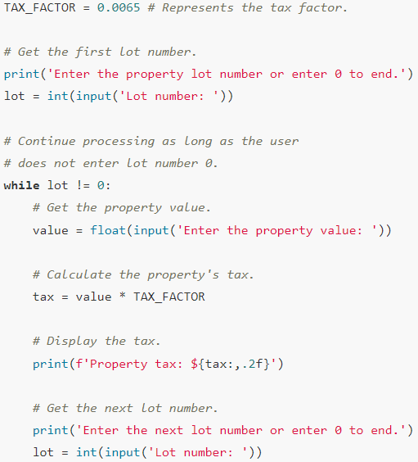
Sentinels Example

Slide 28
Input Validation Loops
Input validation: inspecting input before it is processed by the program
If input is invalid, prompt user to enter correct data
Commonly accomplished using a while loop which repeats as long as the input is bad
If input is bad, display error message and receive another set of data
If input is good, continue to process the input

Slide 29
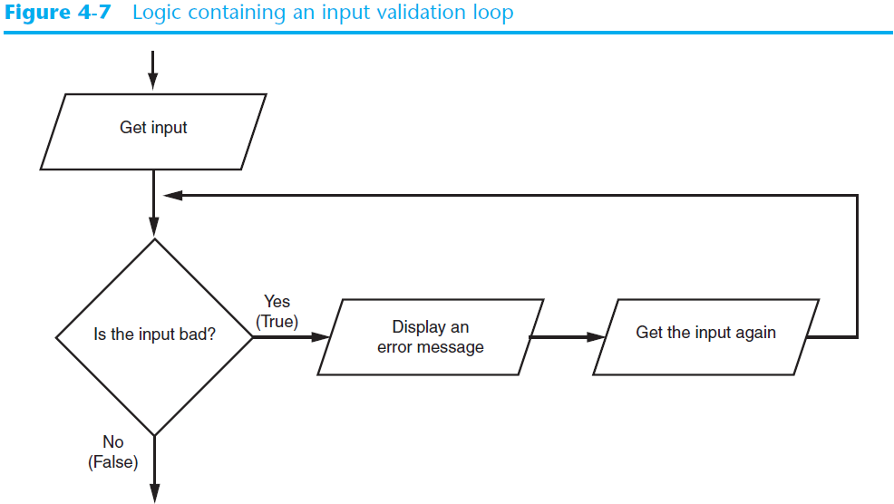
Input Validation Loops (cont’d.)

Slide 30
Input Validation Loops (cont’d.)
Using the walrus operator in an input validation loop
You can use the walrus operator to create an assignment expression that combines the priming read with the input validation loop
Example:
while (score := int(input('Enter your score: '))) < 0:
print('The score cannot be negative.'

Slide 31
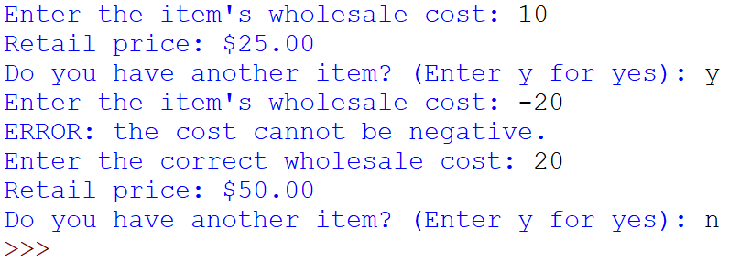
Example: Input Validation Loops
Samantha owns an import business, and she calculates the retail prices of her products with the following formula:
retail price = wholesale cost × 2.5
Let’s write a program that runs in a loop and helps her accomplish the above task.
The input validation will be the fact that the cost entered cannot be negative.

Slide 32
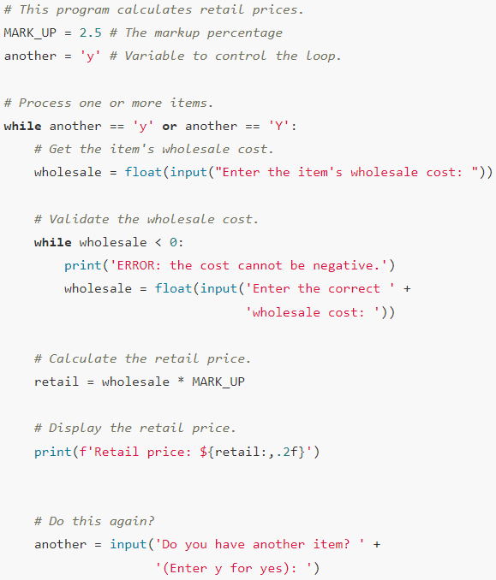
Example: Input Validation Loops

Slide 33
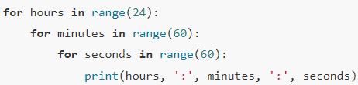
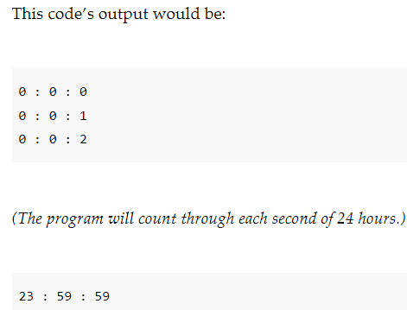
Nested Loops
Nested loop: loop that is contained inside another loop
Inner loop goes through all of its iterations for each iteration of outer loop
Example: analog clock works like a nested loop

Slide 34
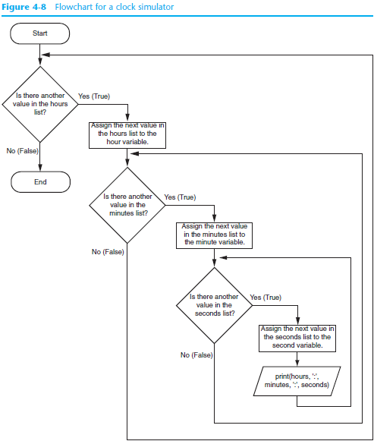

Slide 35
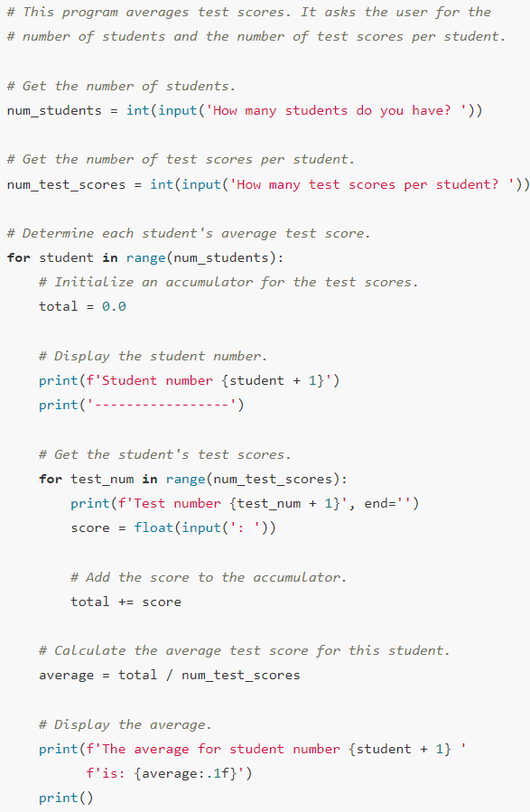
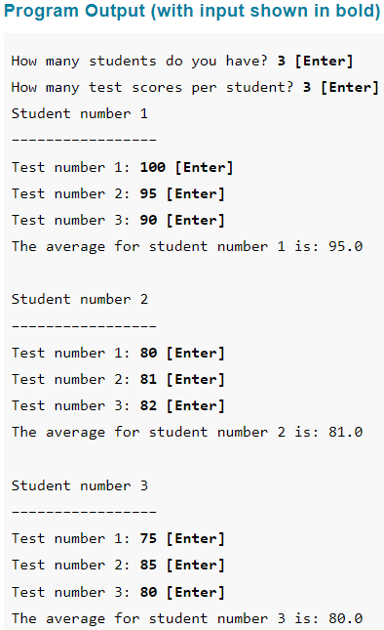
Nested Loops – Another Example

Slide 36
The continue Statement
The continue statement causes the current iteration of a loop to end early
When the continue statement is executed, all the statements in the body of the loop that appear after it are ignored, and the loop begins its next iteration (if there is a next iteration)

Slide 37
The continue Statement
Example:
for num in range(2, 10):
if num % 2 == 0:
print("Found an even number", num)
continue
print("Found an odd number", num)
Program Output
Found an even number 2
Found an odd number 3
Found an even number 4
Found an odd number 5
Found an even number 6
Found an odd number 7
Found an even number 8
Found an odd number 9

Slide 38
The break Statement
The break statement causes a loop to terminate early
n = 0
while n < 100:
print(n)
if n == 5:
break
n += 1
print(f'The loop stopped and n is {n}.')
This statement causes the loop to stop
Program Output
0
1
2
3
4
5
The loop stopped and n is 5.

Slide 39
The else Clause with a Loop
Loops in Python can have an optional else clause.
General Syntax:
while condition:
statement
statement
etc.
else:
statement
statement
etc.
for variable in [value1, value2, etc.]:
statement
statement
etc.
else:
statement
statement
etc.

Slide 40
The else Clause with a Loop
An else clause in a loop is useful only when the loop contains a break statement.
The else clause executes only when the loop terminates normally, without encountering a break statement.
If the loop terminates because of a break statement, the else clause will not execute its block of statements.

Slide 41
The else Clause with a Loop
Example:
n = 5
for x in range(2, n):
if n % x == 0:
print(n, 'equals ', x, '*', n//x)
break
else:
# loop fell through without finding a factor
print(n, 'is a prime number')
The break statement did not execute, so the else clause executed.
Program Output
5 is a prime number

Slide 42
The else Clause with a Loop
Example:
n = 6
for x in range(2, n):
if n % x == 0:
print(n, 'equals ', x, '*', n//x)
break
else:
# loop fell through without finding a factor
print(n, 'is a prime number')
Program Output
6 equals 2 * 3
The else clause did not execute because the break statement executed

Slide 43
Summary
This chapter covered:
Repetition structures, including:
Condition-controlled loops
Count-controlled loops
Nested loops
Infinite loops and how they can be avoided
range function as used in for loops
Calculating a running total and augmented assignment operators
Use of sentinels to terminate loops
Using break, continue, and else with Loops

